Slide 1
PRINCIPLES OF ORGANIZATION
Guided By: PRESENTED BY :
prof.Monica
PADMASHRI
MERCY
MALAN

Slide 2






CONTENTS
MEANING
DEDINITION
PRINCIPLES OF ORGANIZATION

Slide 3









MEANING OF ORGANIZATION :
An organization is a structured group of individuals working together to achieve common goals or objectives. This can include businesses, non-profits, government agencies, and other entities.

Slide 4

































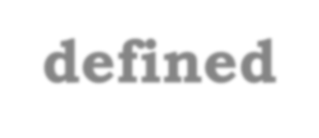




























DEFINITION OF ORGANIZATION :
An organization is a structured group of individuals
who work together to objectives. It involves
achieve specific goals or coordinated activities and
resources to fulfill its mission, often characterized by
defined roles, Organizations can
responsibilities,
and
a hierarchy.
including
vary widely in
type,
businesses, non-profits, social groups, each framework and purpose.
governmental bodies, and
own
operating within its

Slide 5


PRINCIPLES OF ORGANIZATION :
DIVISION OF WORK: Specializing tasks among individuals or teams increases efficiency and productivity.
SPAN OF CONTROL: A manageable number of subordinates per supervisor ensures effective oversight and communication.
DELEGATION OF AUTHORITY: Authority should be delegated to empower employees and promote decision-making at all levels.
COORDINATION: Activities within the organization must be coordinated to achieve common goals effectively.

Slide 6
COORDINATION : Activities within the organization must be coordinated to achieve common goals effectively.
CLARITY OF OBJECTIVES : Goals should be clear and well- communicated to align efforts across the organization.
ACCOUNTABILITY : Individuals should be responsible for their actions and performance, fostering a culture of ownership.
FORMALIZATION : Establishing clear policies, procedures, and documentation ensures consistency and transparency in operations.
FLEXIBILITY : The organization should be adaptable to changes in the environment, allowing it to respond to new challenges and opportunities.

Slide 7
SIMPLICITY: The organizational structure should be as simple as possible to enhance understanding and reduce complexity.
STABILITY OF PERSONNEL: Retaining qualified staff contributes to organizational continuity and performance.
TEAMWORK: Encouraging collaboration and cooperation among team members enhances problem-solving and innovation.
CHAIN OF COMMAND: A clear hierarchy ensures orderly communication and decision-making processes.
EQUITY AND FAIRNESS: Treating employees fairly fosters morale and loyalty, which can lead to increased productivity.

Slide 8
THANK YOU

